Slide 1
Malignant Tumours of the Oral Cavity Types & Presentations
Dr Ashraf Abu Karaky
Oral & Maxillofacial Surgeon
Faculty of Dentistry
University of Jordan

Slide 2
Definition The term "oral" includes the lips and all intra-oral sites corresponding to the ICD9 codes 140 (lip), 141 (tongue), 143 (gum), 144 (floor of mouth) and 145 (other non-specific sites), but excludes sites 142 (major salivary glands), 146 (oropharynx), 147 (nasopharynx), 148 (hypopharynx) and 149 (ill defined oral/oropharynx) Approximately 90% of oral cancers are primary squamous cell carcinomas arising from the lining mucosa of the mouth, most commonly the tongue and the floor of the mouth.

Slide 3
What are malignant oral tumors?
Although there are several types of malignant oral cancers, more than 90 percent of all diagnosed oral cancers are squamous cell carcinoma. This excludes skin lesions the majority of which are basal cell carcinomas
Squamous cell carcinoma: Also known as squamous cell cancer, this type of cancer originates in the squamous cell layer in the lining of the oral cavity and oropharynx. In the early stages, this cancer is present only in the lining layer of cells (called carcinoma in situ). When the cancer spreads beyond the lining, it is called invasive squamous cell cancer.
cancers are squamous cell carcinoma.
squamous cell carcinoma Also known as squamous cell cancer, this type of cancer originates in the squamous cell layer in the lining of the oral cavity and oropharynx. In the early

Slide 4
verrucous carcinoma Although also considered a type of squamous cell carcinoma, this low-grade cancer rarely metastasizes (spreads to distant sites). Comprising less than 5 percent of all diagnosed oral cancers, verrucous carcinoma can spread deeply into surrounding tissue, requiring surgical removal with a wide margin of surrounding tissue
.minor salivary gland cancers The lining of the oral cavity and oropharynx contains numerous salivary glands. Sometimes cancer will originate in a salivary gland. Treatment depends on the type and location of the salivary gland cancer, as well as the extent of spreading. According to the American Cancer Society, salivary gland cancers account for less than 1 percent of all cancers.

Slide 5
Incidence/prevalence
Oral cancer is the sixth most common cancer in the world and is largely preventable.
It accounts for approximately 4% of all cancers and 2% of all cancer deaths world-wide.
In India it is the commonest malignant neoplasm, accounting for 20-30% of all cancers.
Incidence rates show marked geographic variation with the Bas-Rhin region in France having the highest recorded incidence of oral cancer in the world.
Approximately 30,000 persons in the US and 2000 persons in the UK develop oral cancer annually.

Slide 6
The mean UK annual incidence rate for both sexes is approximately 4.5:100,000.
The incidence of head and neck cancer in England and Wales is approximately 11 cases per 100 000 population per year similar to the incidence of malignant disease of the pancreas and the leukaemias and Non-Hodgkin's Lymphoma and is more common than carcinoma of the cervix and malignant melanoma
Ninety five percent of patients with oral cancer are over 40 years of age at diagnosis, and the mean age at diagnosis is 60 years, with a male: female ratio between 1.3:1 and 2:1.

Slide 7
After a steady decline since the turn of the century oral cancer incidence rates in the UK and US are now rising particularly in women.
The incidence of oral cancer in young adults ranges between 0.4% and 3.6%.
Between 10-30% of persons with primary oral cancer develop second primary tumours of the aerodigestive tract at a rate of 3.7% per year.
Metastases to the mouth are rare

Slide 8
Early signs and symptoms of oral cancer
include persistent mouth ulcers (frequently painless)
warty lumps and nodules,
white, red, speckled or pigmented lesions
recent onset of difficulty with speaking or swallowing
enlarged neck nodes.
Any new oral lesion that persists longer than 3-weeks should be referred for an urgent specialist opinion and possible biopsy
Adjunctive use of 1% Toulidine Blue mouthwash can assist in the identification of high-risk patients/lesions.
Approximately 6% of patients with oral cancer present with an enlarged cervical node as their only symptom. All such neck lumps require fine needle aspiration cytological (FNAC) examination before formal excision is considered which in expert hands FNAC has diagnostic accuracy of over 94%.

Slide 9
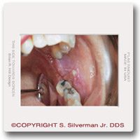
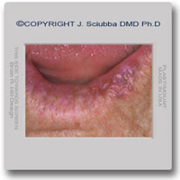
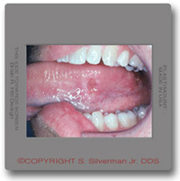
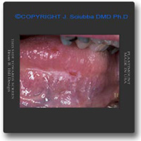

Slide 10
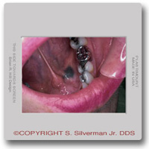
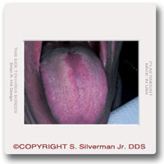
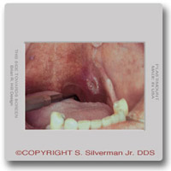

Slide 11
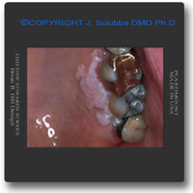
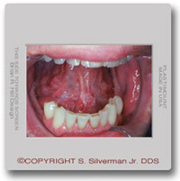
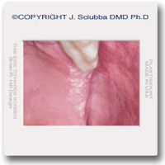

Slide 12
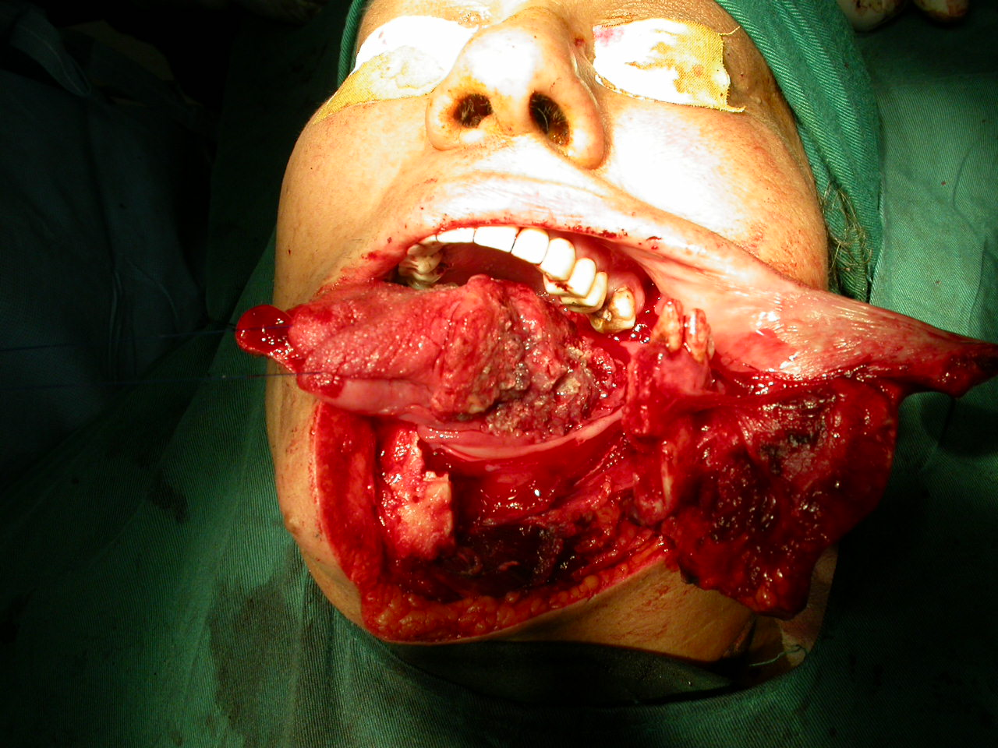

Slide 13
FACTORS AFFECTING RISK
The aetiology of head and neck cancer is complex with many interacting factors, some of which are unknown, but known or likely risk factors should be identified if possible. Some risk factors affecting aetiology are the same as factors affecting the risk of treatment in a particular patient. For example tobacco is a factor affecting the risk of a development of head and neck cancer and increases the risk of the development of a second primary tumour. It also increases the risk of cardiovascular disease in a particular patient which may in turn increase the anaesthetic risk during treatment. Similarly alcohol consumption, besides being synergistic with tobacco may also cause liver disease and therefore excessive bleeding at operation. Both tobacco and alcohol, especially in combination, add to the morbidity of radiotherapy.

Slide 14
Aetiology/risk factors
Globally, tobacco consumption in all its various forms (smoking, chewing & snuff dipping etc.) is the commonest aetiological risk factor.
In developing countries the use of tobacco and /or the areca (betel) nut produces chronic, potentially malignant lesions (leucoplakia, erythroplakia & submucous fibrosis) from which the majority of oral cancers arise. Conversely, in developed countries, potentially malignant lesions are identifiable in only a minority of cases and the majority of oral cancers arise de novo from clinically normal mucosa. These cancers are more aggressive and have a poorer prognosis than those arising within areas of tobacco induced leucoplakia.

Slide 15
In the Western world cigarette smoking is responsible for the majority of all tobacco related oral cancers. The risk of developing oral cancer is directly related to the intensity of tobacco usage with heavy smokers (over 20 cigarettes or 5 cigars per day) having a six fold increased risk of developing the disease compared to non-smokers. Quitting smoking for 10 years or more reduces the odds ratio for developing oral cancer almost to unity. Oral cancer is rare in non-smokers.
Alcohol is an independent risk factor for oral cancer and also acts synergistically with tobacco in an additive or multiplicative fashion. Heavy drinkers (>30 drinks per week) and heavy smokers have a relative risk for developing oral cancer 24 times greater than non-drinkers and non-smokers.

Slide 16
Of the many viruses that are potential candidates for oral carcinogenesis there is little or no evidence at the present time for either the retroviruses, adenoviruses or the Epstein-Barr virus being involved either directly or indirectly. There are some data implicating Herpes simplex viruses (HSV) and the Human papillomaviruses (HPV) in the aetiology of oral cancer although, if they do have an oncogenic role it is likely to be small.
Lower socio-economic status is positively linked with a higher incidence of oral cancer.
First degree relatives of persons with squamous cell carcinoma of the head and neck have a significantly increased relative risk for developing head and neck cancer.

Slide 17
Approximately 15% of oral and oropharyngeal cancers can be attributed to dietary deficiencies or imbalances. Frequent consumption of fresh fruit and vegetables reduces the risk (0.5-0.7) of developing oral and oropharyngeal cancer and b-Carotene and vitamin E can produce regression of oral leucoplakia. Prolonged and heavy consumption of foods rich in nitrites and nitrosamines such as preserved meats and fish significantly increases lifetime risk for the development of oral cancer as may diets low in carotenoids.

Slide 18
What are the risk factors for oral cancer?
Tobacco:The majority of patients with oral cancer (90 percent) use tobacco in one form or another. Tobacco can damage cells in the lining of the oral cavity and oropharynx, causing abnormal cells to grow more rapidly to repair the damage. Researchers believe that the DNA-damaging chemicals in tobacco are linked to the increased risk of oral cancer, according to the American Cancer Society. Alcohol: The majority of patients with oral cancer (75 to 80 percent) use alcohol frequently. Paired with tobacco use, patients who drink and smoke increase their risk of developing oral cancer even more. Researchers have found that alcohol increases the penetration of DNA-damaging chemicals in the lining of the oral cavity and oropharynx, according to the American Cancer Society. | Tobacco use

Slide 19
Sun Light:
Chronic irritation
Lack of fruits and vegetables in diet
Alcohol-containing mouthwash
Human papillomavirus (HPV) infection
Premalignant conditions
Immune system suppression

Slide 20
Chronic iron deficiency
Oro-dental factors such as poor oral hygiene, dental neglect, dental caries, periodontal disease and ill fitting dentures may be risk factors but the evidence is largely anecdotal
Previous treatment with radiotherapy to the head and neck region (for example for Hodgkin's disease) may be a risk factor in the subsequent development of a primary head and neck carcinoma, eg thyroid cancer

Slide 21
Prognosis
Approximately 12,000 people in the US and 900 in the UK die of oral cancer each year. It is a disease of high lethality, comparable to that of carcinoma of the cervix and greater than that of malignant melanoma.
Large tumours with evidence of metastatic spread and tumours thicker than 4mm have a poorer prognosis than those that remain localised to the primary site or are less than 4mm thick.
5-year survival rates are over 80% for persons with early stage disease, over 40% for those with regional disease and less than 20% for patients with metastatic disease.
The status of the cervical nodes is the most important prognostic indicator of survival for patients with oral cancer.
The development of nodal metastases halves the 5-year survival rate.

Slide 22
Factors influence the Prognosis
Early Vs late diagnosis
Extent of disease
Site
Pathology
Age
Treatment
Notes:
Posterior worst tham anterior
Best lip, tongue early metastasis
Age cell mediated response

Slide 23
The TNM staging system
Another method of staging oral carcinomas is referred to as the TNM method. In this method T describes the tumor, N describes the lymph nodes, and M describes distant metastasis.

Slide 24
TX No available information on primary tumor T0 No evidence of primary tumor T1S Carcinoma in situ T1 Tumor 2 cm or less in greatest dimension T2 Tumor more than 2 cm but not more than 4 cm in greatest dimension T3 Tumor more than 4 cm in greatest dimension.
T4 (Oral cavity) Tumor invades adjacent structures (e.g., through cortical bone, into deep [extrinsic] muscle of tongue, maxillary sinus, skin)

Slide 25
NX Regional lymph nodes cannot be assessed N0 No regional lymph node metastasis N1 Metastasis in a single ipsilateral lymph node, 3 cm or less in greatest dimension N2 Metastasis in a single ipsilateral lymph node, more than 3 cm but not more than 6 cm in greatest dimension; or multiple ipsilateral positive lymph nodes none more than 6 cm in diameter

Slide 26
N2a Metastasis in single ipsilateral lymph node more than 3 cm but not more than 6 cm in greatest dimension N2b Metastasis in multiple ipsilateral lymph nodes, none more than 6 cm in greatest dimension N3 Metastasis in a lymph node more than 6 cm in greatest dimension(N3a), bliateral nodes (N3b) contralateral node or nodes (N3c).

Slide 27
MX Presence of distant metastasis cannot be assessed M0 No distant metastasis M1 Distant metastasis

Slide 28
Staging
5yr survival
Stage I T1 N0 M0 85%
Stage II T2 N0 M0 66%
Stage III T3 N0 M0 41%
Any T1, T2, T3 + N1 M0
Stage IV 9%
Any T4
Any N2 or N3
Any M1

Slide 29
HEAD AND NECK CANCER PREVENTION
The most important and well known are the consumption of tobacco and alcohol and it is theoretically possible to prevent a significant number of head and neck cancers if these risk factors, in particular tobacco consumption, were eliminated although increasing numbers of young patients presenting with head and neck cancer have not been exposed to these risk factors.
Early detection of head and neck cancer could reduce morbidity and may reduce mortality and forms an important part of these guidelines. There is a need for more public education and awareness of early symptoms of head and neck cancer (for example Oral Cancer Awareness Week, October 1995, BAOMS, and the importance of an early diagnosis of hoarse voice and persistent oral ulcers

Slide 30
Opportunistic screening by primary clinicians and workers is important, as is targeted screening of high risk groups. For example, appropriately trained dentists working in the general dental services could form a near ideal screening service for cancers and potentially cancerous lesions arising in the oral cavity.
Research is needed into education for early detection, causative factors (other than known factors) eg. HPV, imaging for accurate staging and the possibility and effectiveness of new treatment modalities
Because of the particularly distressing nature of head and neck cancer, quality of life and functional outcome studies are particularly relevant.

Slide 31
Thank you

